Slide 1


WCD Midterm Project
Steven Yuen

Slide 2
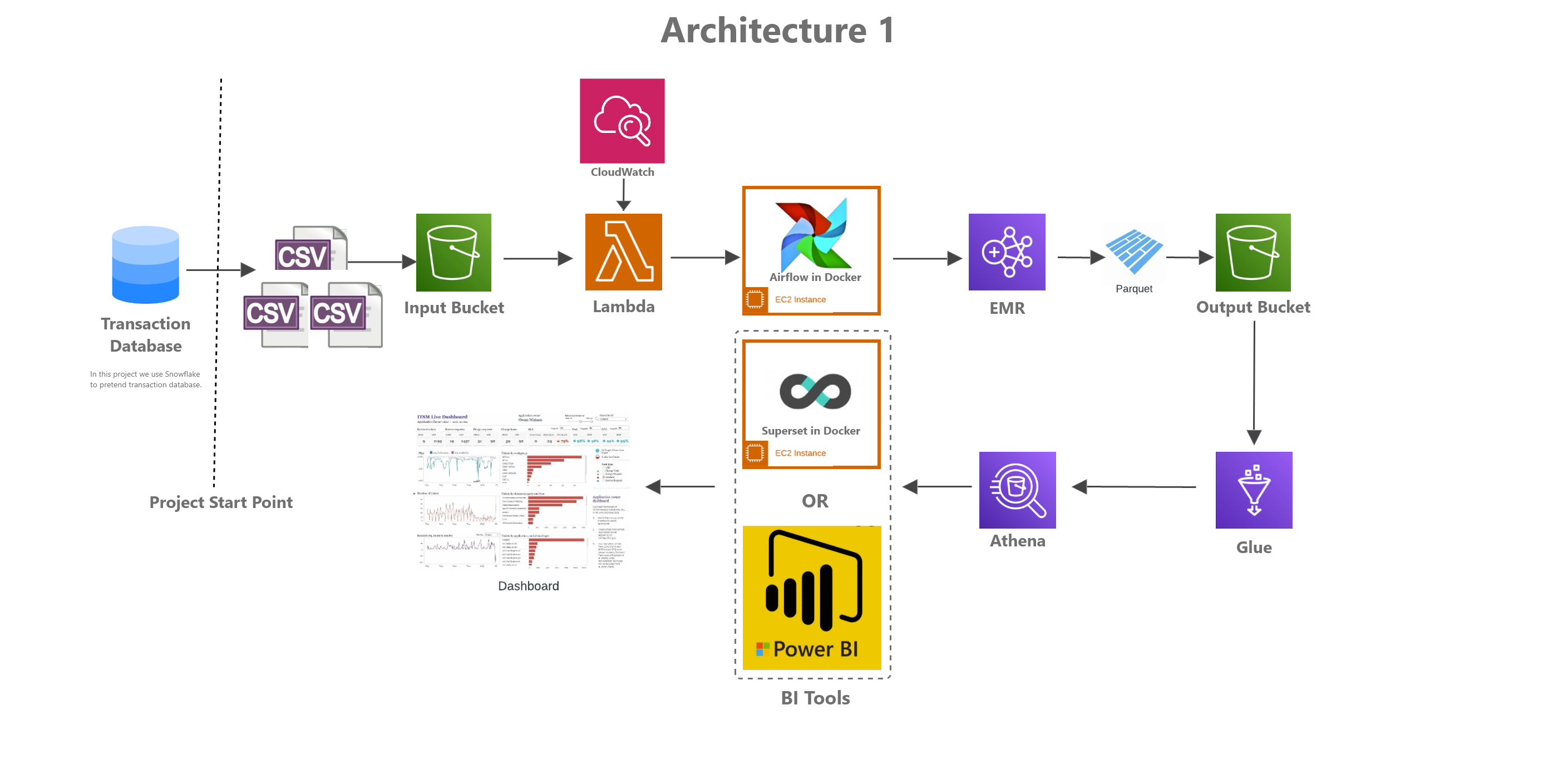

Architecture

Slide 3
Snowflake, S3, Lambda and Docker
Snowflake is the data warehouse that uploads the data to s3 every 1 am EST.
Lambda is used to execute the pipeline and check the required files are present from the AWS S3 bucket. CloudWatch is used to start the program at 2 am EST. An email will be sent out if required files are not present.
Going forward Airflow and Superset are dockerized on the EC2 instance

Slide 4
EC2 and Airflow
EC2 instance is used to power my airflow pipeline.
The DAG creates the following:
Create the EMR instance to run my transformation script
Retrieve the files from s3 after being verified by lambda
After EMR is set up uses the transformation script (stored in s3 as well) to clean and transform the data
Uploads the results to a new s3 bucket in parquet format
Terminates EMR instance once all jobs ran successfully

Slide 5
Athena, Glue and Superset
AWS Glue crawler is used to read and upload the parquet files into AWS Athena
Athena is the analytics tool used to query the data
Apache Superset is the visualization tool used to display the data in a manner that is suitable for decision making. Apache superset will be connected to Athena and will still be used to query the data for the charts.

Slide 6
Things I have learned & Challenges
Version matters, a lot. I ran into several compatibility issues if I don’t match the correct versions. Taught me the value of Docker
Setting up AWS with airflow took very long for me, the airflow took well over 60% of the time due to reading documentation, version compatibility and error debugging.
The scope of knowledge required to be a data engineer
Importance of logging and reading error codes (debugging)

Slide 7
Things I could have added (done better)
IAM roles could have been made better, I was focused on making the project work so gave full access privileges. Me now being more familiar I can more confidently set up least privileges for future projects.
The entirety of the project most likely been automated including the data analysis part with athena, glue and superset. If given more time I could it so the final chart will be also uploaded to s3 as well
Better formatting, date folders, cleaning s3 buckets, more comments on code.
Save more money by remembering to close EC2.

